Slide 1
Chapter 10
How to work with model binding

Slide 2
Objectives (part 1)
Applied
Use model binding with primitive and complex types.
Knowledge
Describe how to use controller properties to retrieve primitive types from GET and POST requests.
List the order of places where MVC looks for data when it’s binding a parameter.
Describe how to use model binding to retrieve primitive types from GET and POST requests.
Describe how to use model binding to retrieve complex types from POST requests.
Describe how to use the name and value attributes of a submit button to POST data.

Slide 3
Objectives (part 2)
Describe how to post an array to an action method.
Describe the use of attributes to control the source of bound values.
Describe the use of attributes to control which properties are set during model binding.

Slide 4
Two properties of the Controller class
Request
RouteData
Two properties of the Request property
Query
Form
One property of the RouteData property
Values

Slide 5
A URL with a query string parameter
https://localhost:5001/Home/Index?page=2
An action method that retrieves the value of the query string parameter
public IActionResult Index() {
ViewBag.Page = Request.Query["page"];
return View();
}

Slide 6
Form data in the body of a POST request
firstname=Grace
An action method that retrieves the form data
public IActionResult Index() {
ViewBag.FirstName = Request.Form["firstname"];
return View();
}

Slide 7
A URL with a value for the id parameter of the default route
https://localhost:5001/Home/Index/all
An action method that retrieves the value of the route parameter named id
public IActionResult Index() {
ViewBag.Id = RouteData.Values["id"];
return View();
}

Slide 8
An action method that uses model binding to get a string value
public IActionResult Index(string id)
{
ViewBag.Id = id;
return View();
}
Three types of data this method can retrieve
A form parameter in the body of a POST request
id=2
A route parameter
https://localhost:5001/Home/Index/2
A query string parameter
https://localhost:5001/Home/Index?id=2

Slide 9
The order in which MVC looks for data to bind to a parameter
The body of the POST request.
The route values in the URL.
The query string parameters in the URL.

Slide 10
The benefits of model binding
You don’t have to write repetitive code to retrieve values.
MVC automatically casts the value to match the data type of the action method parameter.
Model binding is not case sensitive.
You can change how you pass data to an action without having to change its code.

Slide 11
An action method and view that bind to primitive types
The action method
[HttpPost]
public IActionResult Add(string description,
DateTime dueDate){
ToDo task = new ToDo {
Description = description,
DueDate = duedate
};
// rest of code
}
The view
<form asp-action="Add" method="post">
<label for="description">Description:</label>
<input type="text" name="description">
<label for="duedate">Due Date:</label>
<input type="text" name="duedate">
<button type="submit">Add</button>
</form>

Slide 12
The class for a complex type
public class ToDo
{
public int Id { get; set; }
public string Description { get; set; }
public DateTime? DueDate { get; set; }
}

Slide 13
An action method and view that bind to a complex type
The action method
[HttpPost]
public IActionResult Add(ToDo task){
// rest of code
}
The view
@model ToDo
...
<form asp-action="Add" method="post">
<label asp-for="Description">Description:</label>
<input asp-for="Description">
<label asp-for="DueDate">Due Date:</label>
<input type="text" asp-for="DueDate">
<button type="submit">Add</button>
</form>

Slide 14
The custom route in the NFL Teams app
endpoints.MapControllerRoute(
name: "custom",
pattern:
"{controller=Home}/{action=Index}/conf/{activeConf}/div/{activeDiv}");

Slide 15
A Home/Index() action method that binds to primitive types
public IActionResult Index(string activeConf = "all",
string activeDiv = "all")
{
var model = new TeamListViewModel
{
ActiveConf = activeConf,
ActiveDiv = activeDiv,
Conferences = context.Conferences.ToList(),
Divisions = context.Divisions.ToList()
};
IQueryable<Team> query = context.Teams;
// conditional where clauses based
// on active conference and division
model.Teams = query.ToList();
return View(model);
}

Slide 16
The updated base class for the TeamListViewModel class
public class TeamViewModel
{
public Team Team { get; set; }
public string ActiveConf { get; set; } = "all";
public string ActiveDiv { get; set; } = "all";
}
A Home/Index() action method that binds to a complex type
public IActionResult Index(TeamListViewModel model)
{
model.Conferences = context.Conferences.ToList();
model.Divisions = context.Divisions.ToList();
IQueryable<Team> query = context.Teams;
// conditional where clauses based
// on active conference and division
model.Teams = query.ToList();
return View(model);
}

Slide 17
An action method
[HttpPost]
public IActionResult Add(Team team)
{
// action method code
}

Slide 18

An <input> element for a button that posts a team ID to the action method
@model Team;
...
<form asp-action="Add" method="post">
<input type="submit" asp-for="TeamID"
class="btn btn-primary" />
</form>
How the button looks in the browser

Slide 19

A <button> element for a button that posts a team ID to the action method
@model Team;
...
<form asp-action="Add" method="post">
<button type="submit" name="TeamID"
value="@Model.TeamID"
class="btn btn-primary">@Model.Name</button>
</form>
How the button looks in the browser

Slide 20
The <input> element…
Allows you to use the asp-for tag helper to generate the name and value attributes.
Automatically displays the value attribute as the text for the button.
The <button> element…
Gives you control over the text (or image) that’s displayed on the button.
Requires you to manually code the name and value attributes.
Requires you to make sure the value in the name attribute matches the name of the action method parameter or property.

Slide 21
An action method that binds to a model
[HttpPost]
public IActionResult Details(TeamViewModel model)
{
TempData["ActiveConf"] = model.ActiveConf;
TempData["ActiveDiv"] = model.ActiveDiv;
return RedirectToAction("Details",
new { ID = model.Team.TeamID });
}

Slide 22
Part of a view that uses a hidden field to post the team ID
<ul class="list-inline">
@foreach (Team team in Model.Teams)
{
<li class="list-inline-item">
<form asp-action="Details" method="post">
<button type="submit">
<img src="~/images/@team.LogoImage"
alt="@team.Name"
title="@team.Name |
@team.Conference.Name
@team.Division.Name" />
</button>
<input type="hidden" asp-for="@team.TeamID" />
<input type="hidden" asp-for="ActiveConf" />
<input type="hidden" asp-for="ActiveDiv" />
</form>
</li>
}
</ul>

Slide 23
Part of a view that uses a submit button to post the team ID
<form asp-action="Details" method="post">
<input type="hidden" asp-for="ActiveConf" />
<input type="hidden" asp-for="ActiveDiv" />
<ul class="list-inline">
@foreach (Team team in Model.Teams)
{
<li class="list-inline-item">
<button type="submit"
name="Team.TeamID"
value="@team.TeamID">
<img src="~/images/@team.LogoImage"
alt="@team.Name"
title="@team.Name |
@team.Conference.Name
@team.Division.Name" />
</button>
</li>
}
</ul>
</form>

Slide 24
An action method that accepts a string array
[HttpPost]
public IActionResult Filter(string[] filter)
{
// code that does the filtering
return View();
}

Slide 25
A view that posts a string array to the method
<h3>Filter By:</h3>
<form asp-action="Filter" method="post">
<!-- make sure each select element has the same name
and that it matches the action method parameter name -->
<label>Price</label>
<select name="filter">
<option value="all">All</option>
<option value="lt10">Under $10</option>
<option value="10to50">$10 to $50</option>
<option value="gt50">Over $50</option>
</select>
<label>Color</label>
<select name="filter">
<option>All</option>
<option>Red</option>
<option>Blue</option>
<option>Yellow</option>
<option>Green</option>
<option>Purple</option>
</select>
<button type="submit">Filter</button>
</form>

Slide 26
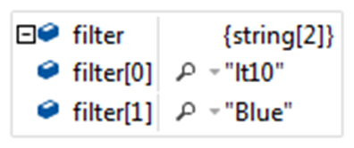
The string array the action method receives

Slide 27
Some of the attributes that specify the source of the value to be bound
[FromForm]
[FromRoute]
[FromQuery]
[FromHeader]
[FromServices]
[FromBody]

Slide 28
An action method that specifies the source of its parameters
public IActionResult Index([FromRoute] string id, [FromQuery] int pagenum)
{
ViewBag.Id = id;
ViewBag.Page = pagenum;
return View();
}

Slide 29
An action method that passes an argument to an attribute
public IActionResult Index(
[FromHeader(Name = "User-Agent")] string agent)
{
ViewBag.UserAgent = agent;
return View();
}

Slide 30
A class that applies an attribute to a property
public class Browser
{
[FromHeader(Name = "User-Agent")]
public string UserAgent { get; set; }
...
}

Slide 31
Attributes that determine which values are bound
[Bind(names)]
[BindNever]
The namespaces of the attributes
Attribute Namespace
[Bind] Microsoft.AspNetCore.MVC
[BindNever] Microsoft.AspNetCore.MVC.ModelBinding

Slide 32
The Employee class
public class Employee {
public string Name { get; set; }
public string JobTitle { get; set; }
public bool IsManager { get; set; }
}

Slide 33
Three ways to make sure the IsManager property is not bound (part 1)
With the Bind attribute in the parameter list of an action method
[HttpPost]
public IActionResult Index(
[Bind("Name", "JobTitle")] Employee employee) {
if (ModelState.IsValid) {
if (employee.JobTitle == "Boss")
employee.IsManager = true; // can be set in code
}
return View(employee);
}

Slide 34
Three ways to make sure the IsManager property is not bound (part 2)
With the Bind attribute on the class
[Bind("Name", "JobTitle")]
public class Employee {
public string Name { get; set; }
public string JobTitle { get; set; }
public bool IsManager { get; set; }
}

Slide 35
Three ways to make sure the IsManager property is not bound (part 3)
With the BindNever attribute on the IsManager property
public class Employee {
public string Name { get; set; }
public string JobTitle { get; set; }
[BindNever]
public bool IsManager { get; set; }
}

Slide 36
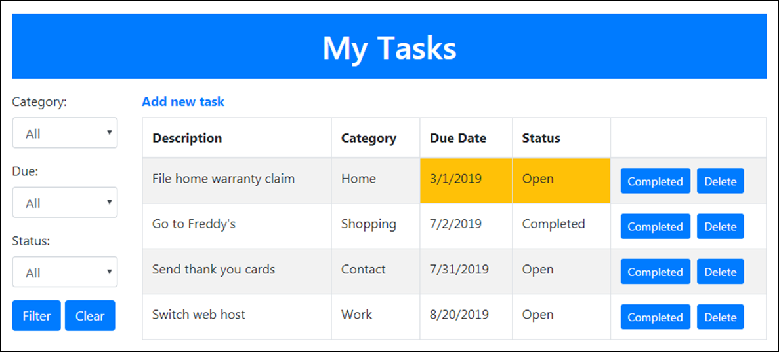
The Home page of the ToDo List app with no filtering

Slide 37
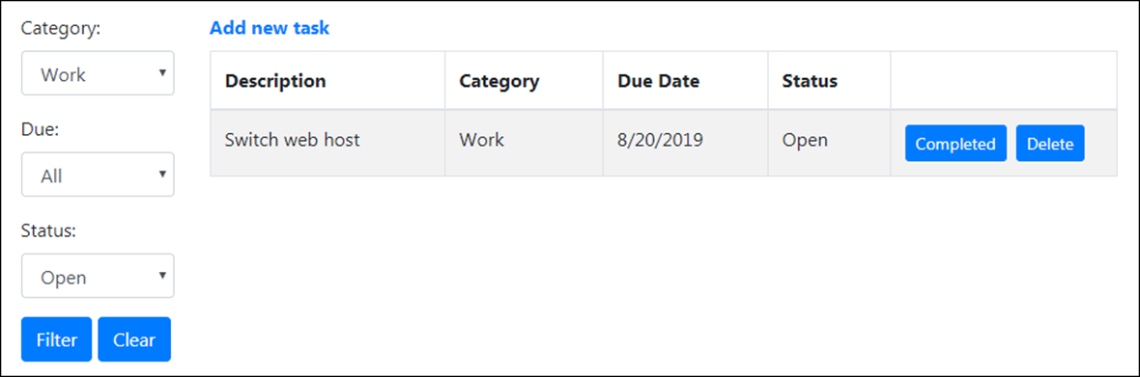
The Home page after it has been filtered to show open work tasks

Slide 38
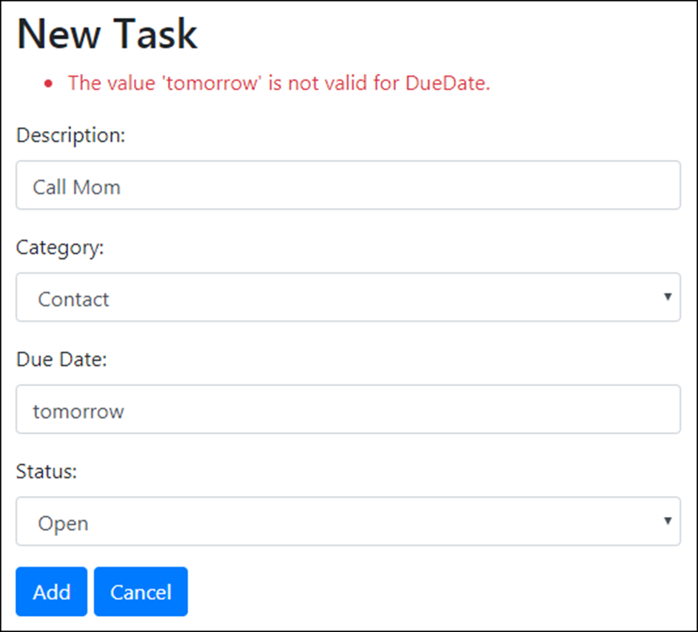
The Add page with a validation message

Slide 39
The Category class
public class Category
{
public string CategoryId { get; set; }
public string Name { get; set; }
}
The Status class
public class Status
{
public string StatusId { get; set; }
public string Name { get; set; }
}

Slide 40
The ToDo class
public class ToDo
{
public int Id { get; set; }
[Required(ErrorMessage = "Please enter a description.")]
public string Description { get; set; }
[Required(ErrorMessage = "Please enter a due date.")]
public DateTime? DueDate { get; set; }
[Required(ErrorMessage = "Please select a category.")]
public string CategoryId { get; set; }
public Category Category { get; set; }
[Required(ErrorMessage = "Please select a status.")]
public string StatusId { get; set; }
public Status Status { get; set; }
public bool Overdue =>
Status?.ToLower() == "open" && DueDate < DateTime.Today;
}

Slide 41
The ToDoContext class
public class ToDoContext : DbContext
{
public ToDoContext(DbContextOptions<ToDoContext> options)
: base(options) { }
public DbSet<ToDo> ToDos { get; set; }
public DbSet<Category> Categories { get; set; }
public DbSet<Status> Statuses { get; set; }
protected override void OnModelCreating(
ModelBuilder modelBuilder) {
modelBuilder.Entity<Category>().HasData(
new Category { CategoryId = "work", Name = "Work" },
new Category { CategoryId = "home", Name = "Home" },
new Category { CategoryId = "ex", Name = "Exercise" },
new Category { CategoryId = "shop", Name = "Shopping" },
new Category { CategoryId = "call", Name = "Contact" }
);
modelBuilder.Entity<Status>().HasData(
new Status { StatusId = "open", Name = "Open" },
new Status { StatusId = "closed", Name = "Completed" }
);
}
}

Slide 42
The Filters class (part 1)
public class Filters
{
public Filters(string filterstring)
{
FilterString = filterstring ?? "all-all-all";
string[] filters = FilterString.Split('-');
CategoryId = filters[0];
Due = filters[1];
StatusId = filters[2];
}
public string FilterString { get; }
public string CategoryId { get; }
public string Due { get; }
public string StatusId { get; }
public bool HasCategory => CategoryId.ToLower() != "all";
public bool HasDue => Due.ToLower() != "all";
public bool HasStatus => StatusId.ToLower() != "all";

Slide 43
The Filters class (part 2)
public static Dictionary<string, string> DueFilterValues =>
new Dictionary<string, string> {
{ "future", "Future" },
{ "past", "Past" },
{ "today", "Today" }
};
public bool IsPast => Due.ToLower() == "past";
public bool IsFuture => Due.ToLower() == "future";
public bool IsToday => Due.ToLower() == "today";
}

Slide 44
The Home controller (part 1)
public class HomeController : Controller
{
private ToDoContext context;
public HomeController(ToDoContext ctx) => context = ctx;
public IActionResult Index(string id)
{
var filters = new Filters(id);
ViewBag.Filters = filters;
ViewBag.Categories = context.Categories.ToList();
ViewBag.Statuses = context.Statuses.ToList();
ViewBag.DueFilters = Filters.DueFilterValues();
IQueryable<ToDo> query = context.ToDos
.Include(t => t.Category).Include(t => t.Status);
if (filters.HasCategory) {
query = query.Where(t =>
t.CategoryId == filters.CategoryId);
}
if (filters.HasStatus) {
query = query.Where(t =>
t.StatusId == filters.StatusId);
}

Slide 45
The Home controller (part 2)
if (filters.HasDue) {
var today = DateTime.Today;
if (filters.IsPast)
query = query.Where(t => t.DueDate < today);
else if (filters.IsFuture)
query = query.Where(t => t.DueDate > today);
else if (filters.IsToday)
query = query.Where(t => t.DueDate == today);
}
var tasks = query.OrderBy(t => t.DueDate).ToList();
return View(tasks);
}
[HttpGet]
public IActionResult Add()
{
ViewBag.Categories = context.Categories.ToList();
ViewBag.Statuses = context.Statuses.ToList();
return View();
}

Slide 46
The Home controller (part 3)
[HttpPost]
public IActionResult Add(ToDo task)
{
if (ModelState.IsValid){
context.ToDos.Add(task);
context.SaveChanges();
return RedirectToAction("Index");
}
else {
ViewBag.Categories = context.Categories.ToList();
ViewBag.Statuses = context.Statuses.ToList();
return View(task);
}
}
[HttpPost]
public IActionResult Filter(string[] filter)
{
string id = string.Join('-', filter);
return RedirectToAction("Index", new { ID = id });
}

Slide 47
The Home controller (part 4)
[HttpPost]
public IActionResult Edit([FromRoute] string id, ToDo selected)
{
if (selected.StatusId == null) {
context.ToDos.Remove(selected);
}
else {
string newStatusId = selected.StatusId;
selected = context.ToDos.Find(selected.Id);
selected.StatusId = newStatusId;
context.ToDos.Update(selected);
}
context.SaveChanges();
return RedirectToAction("Index", new { ID = id });
}
}

Slide 48
The layout
<!DOCTYPE html>
<html>
<head>
<meta name="viewport" content="width=device-width" />
<link href="~/lib/bootstrap/dist/css/bootstrap.min.css"
rel="stylesheet" />
<title>My Tasks</title>
</head>
<body>
<div class="container">
<header class="bg-primary text-white text-center">
<h1 class="m-3 p-3">My Tasks</h1>
</header>
<main>
@RenderBody()
</main>
</div>
</body>
</html>

Slide 49
The Home/Index view (part 1)
@model IEnumerable<ToDo>
@{
string Overdue(ToDo task) => task.Overdue ? "bg-warning" : "";
}
<div class="row">
<div class="col-sm-2">
<form asp-action="Filter" method="post">
<div class="form-group">
<label>Category:</label>
<select name="filter" class="form-control"
asp-items="@(new SelectList(ViewBag.Categories,
"CategoryId", "Name",
ViewBag.Filters.CategoryId))">
<option value="all">All</option>
</select></div>
<div class="form-group">
<label>Due:</label>
<select name="filter" class="form-control"
asp-items="@(new SelectList(ViewBag.DueFilters,
"Key", "Value", ViewBag.Filters.Due))">
<option value="all">All</option>
</select></div>

Slide 50
The Home/Index view (part 2)
<div class="form-group">
<label>Status:</label>
<select name="filter" class="form-control"
asp-items="@(new SelectList(ViewBag.Statuses,
"StatusId", "Name",
ViewBag.Filters.StatusId))">
<option value="all">All</option>
</select>
</div>
<button type="submit" class="btn btn-primary">
Filter</button>
<a asp-action="Index" asp-route-id=""
class="btn btn-primary">Clear</a>
</form>
</div>

Slide 51
The Home/Index view (part 3)
<div class="col-sm-10">
<a asp-action="Add"><b>Add new task</b></a>
<table class="table table-bordered table-striped mt-2">
<thead>
<tr>
<th>Description</th>
<th>Category</th>
<th>Due Date</th>
<th>Status</th>
<th class="w-25"></th>
</tr>
</thead>
<tbody>
@foreach (ToDo task in Model)
{
string overdue = Overdue(task);
<tr>
<td>@task.Description</td>
<td>@task.Category.Name</td>
<td class="@overdue">
@task.DueDate?.ToShortDateString()</td>
<td class="@overdue">@task.Status.Name</td>

Slide 52
The Home/Index view (part 4)
<td>
<form asp-action="Edit" method="post"
asp-route-id="@ViewBag.Filters.FilterString"
class="mr-2">
<input type="hidden"
name="@nameof(ToDo.Id)" value="@task.Id" />
<button type="submit"
name="@nameof(ToDo.StatusId)" value="closed"
class="btn btn-primary btn-sm">Completed
</button>
<button type="submit"
class="btn btn-primary btn-sm">Delete
</button>
</form>
</td>
</tr>
}
</tbody>
</table>
</div>
</div>

Slide 53
The Home/Add view (part 1)
@model ToDo
<h2>New Task</h2>
<div asp-validation-summary="All" class="text-danger">
</div>
<form asp-action="Add" method="post">
<div class="form-group">
<label asp-for="Description">Description:</label>
<input asp-for="Description" class="form-control">
</div>
<div class="form-group">
<label asp-for="CategoryId">Category:</label>
<select asp-for="CategoryId" class="form-control"
asp-items="@(new SelectList(ViewBag.Categories,
"CategoryId", "Name"))">
<option value=""></option>
</select>
</div>

Slide 54
The Home/Add view (part 2)
<div class="form-group">
<label asp-for="DueDate">Due Date:</label>
<input type="text" asp-for="DueDate"
class="form-control">
</div>
<div class="form-group">
<label asp-for="StatusId">Status:</label>
<select asp-for="StatusId" class="form-control"
asp-items="@(new SelectList(ViewBag.Statuses,
"StatusId", "Name"))">
<option value=""></option>
</select>
</div>
<button type="submit" class="btn btn-primary">
Add</button>
<a asp-action="Index" class="btn btn-primary">
Cancel</a>
</form>

